Slide 1
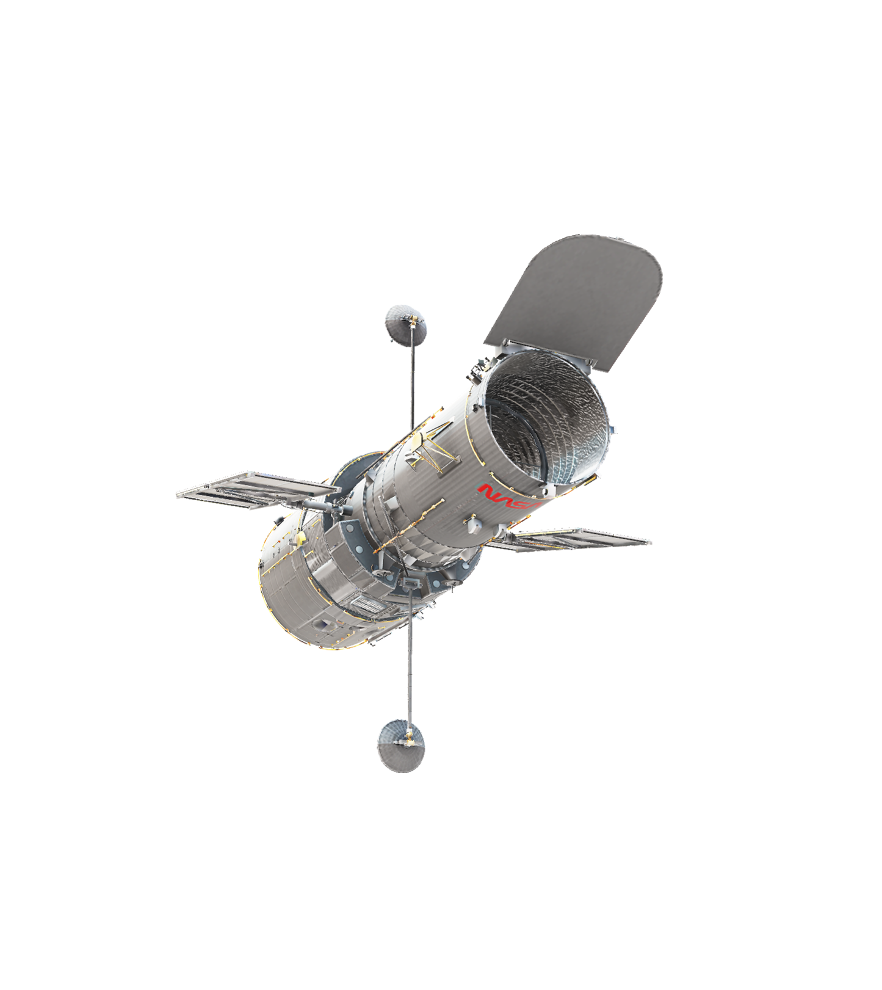
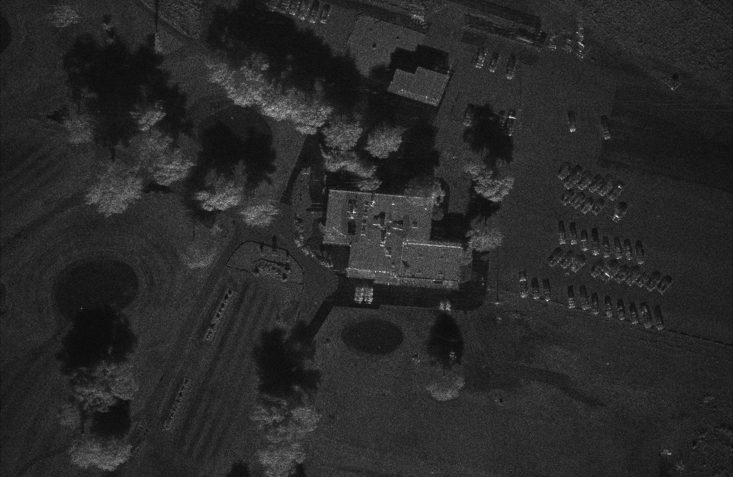
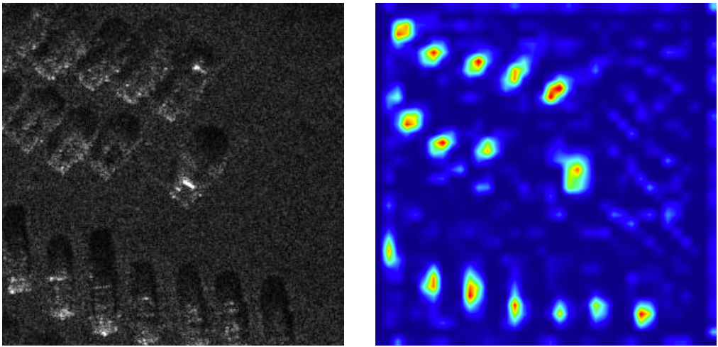
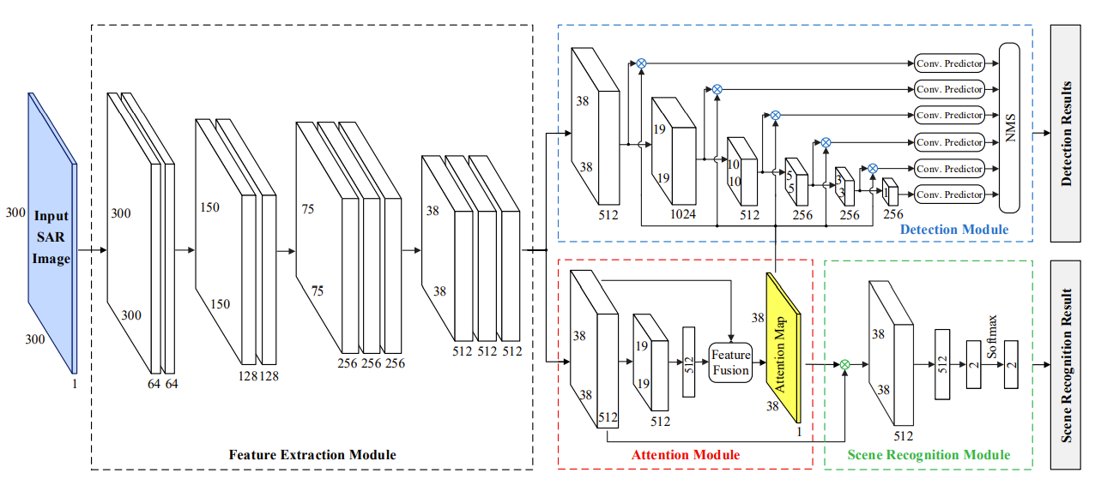
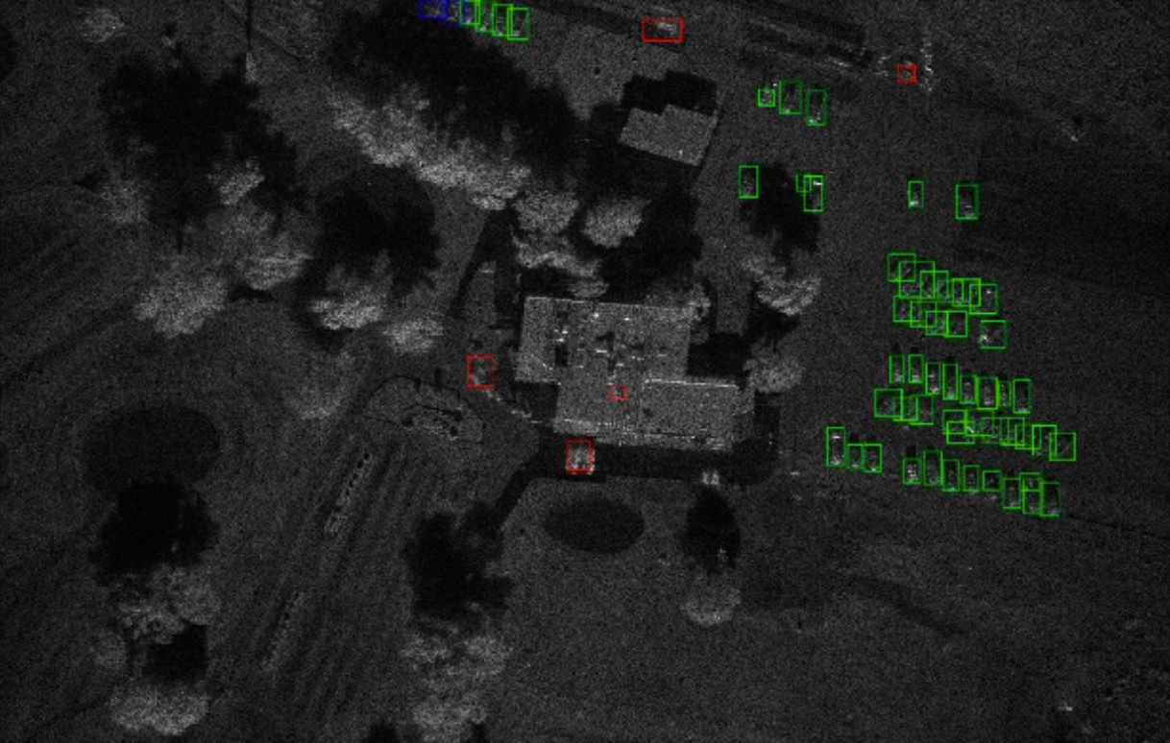
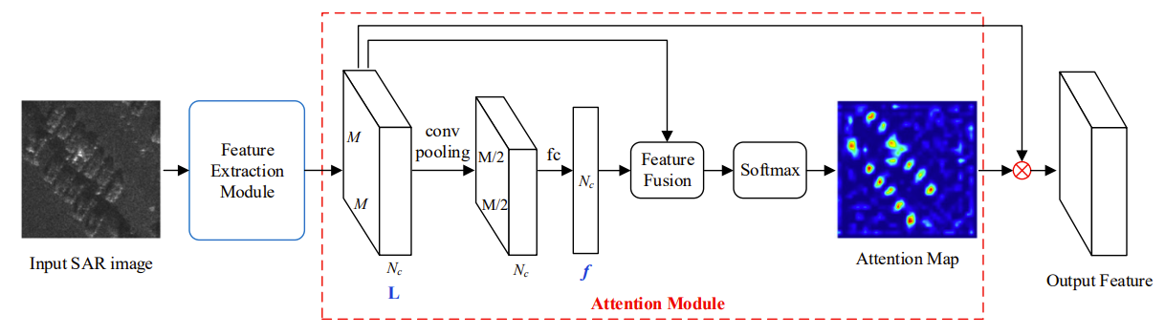
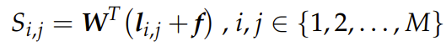
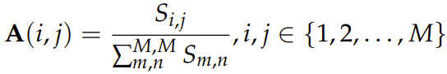
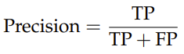
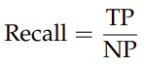
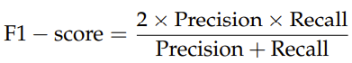

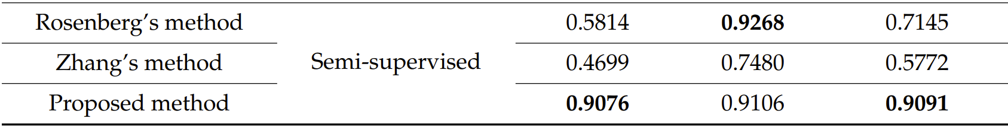
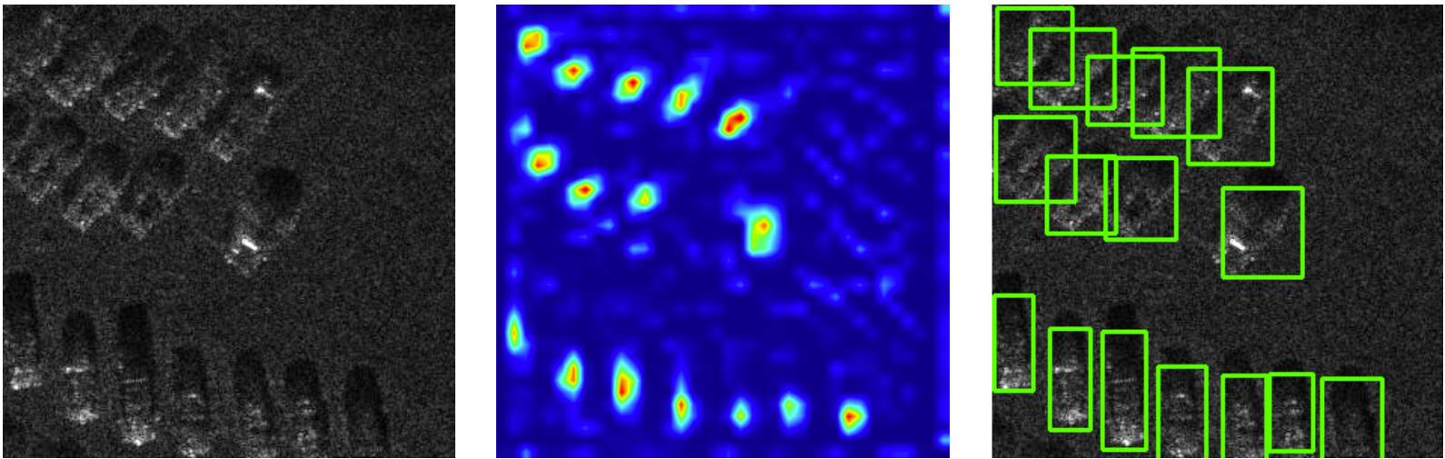
Attention-Based Techniques for Target Detection in Synthetic Aperture Radar Images
Auteur : Hadrien BONTEMPS
Encadrants : Abdelmalek TOUMI
Background and Issues
Synthetic Aperture Radar (SAR) images pose a challenge to traditional target detection approaches, especially in complex scenes where speckle noise gets substantial, and targets become very hard to distinguish from clutter.
These past few years, a new class of techniques mimicking cognitive attention, know as attention mechanisms, has sparked interest in the field. The idea of attention is to train convolution neural networks (CNNs) to focus on meaningful parts of the data.
Figure 1. A complex scene with many trees, buildings and vehicles
A few attempts have been made to integrate attention mechanisms in CNN architectures and have achieved remarkable performance. However, these methods have always relied on fully-supervised learning, which is extremely time-consuming.
This project focuses on a novel approach introduced in 2021 by Di Wei et al. for target detection in SAR images via both semi-supervised learning and attention mechanism.
CONCLUSIONS
(a)
(b)
Figure 2. A SAR image (a) and its corresponding attention map (b)
The presented method proposes a target detection network based on semi-supervised learning and attention mechanism, aiming at a reduced labeling workload and better performances on complex scenes. The Single Shot Detection (SSD) algorithm is used to learn to locate the targets form ground truth bounding boxes, and its performance is improved by a scene recognition branch which learns from image-level labeled training samples. An attention mechanism automatically guides the network to focus and the targets of interest while ignoring the background clutter.
The results obtained on the MiniSAR dataset show that this novel approach outperforms most of the state-of-the-art target detection methods in SAR images, with only 30% of the training samples labeled at target level.
Algorithm description
SAR images are cropped into many 300 × 300 sub-images. For each sub-image, we mark whether it contains any target or not (image-level label) and if it does, we draw the bounding boxes for every target (target-level labels). All sub-images are first fed into a feature extraction module to extract their deep features, followed by an attention module. Then, image-level labeled images go through a scene recognition module which learns to differentiate targets from clutter, and target-level labeled images go through a detection module which outputs the locations of the bounding boxes based on the Single Shot Detection algorithm coupled with a Non-Maximum Suppression final step to suppress redundant boxes.
Figure 3. Global architecture of the proposed SAR target detection network
In the attention module, the deep features L are first fed into a convolutional layer followed by a max pooling operation to down-sample the feature maps. Finally, a fully connected layer is adopted to obtain the global descriptor f. An attention map is acquired by fusing the local features li,j with the global descriptor f with a compatibility measure:
and then normalizing the fusion by softmax operation:
Figure 6. Detection results on a test MiniSAR image
(Green: correctly detected target chips - Red: false alarms - Blue: missing alarms
PROSPECTS
Figure 4. Flowchart of the attention module
Lighten the network architecture to reduce its training time:
Although the proposed method can significantly improve the performance of target detection, its computational complexity and runtime are too high. A lightweight version of the network will have to be considered in the future to improve the detection speed.
Combine this method to traditional target detection algorithms:
Although at present, CNN-based methods outperform past approaches, it would be interesting to not completely abandon traditional target detection algorithms. Texture features might for instance be considered to reduce the number of false alarms.
Pre-process the SAR images:
Many despeckling techniques have been employed to reduce the noise in SAR images and consequently improve the performance of target detectors. Extra effort can be made to enhance the quality of SAR datasets.
M: spatial size of L
Nc: channel dimension of L
W: learnable weight
f: global descriptor
li,j : local features of L at spatial position (i, j)
Note that in both the Scene Recognition and Detection modules, the multi-scale feature maps and the attention map are dot-multiplied according to the spatial position, which automatically enhances the features of the target area and suppress the clutter area.
Results
The proposed algorithm was tested on the MiniSAR dataset, which consists of 20 images of size 1638 × 2510 and 0.1 m × 0.1 m resolution that were acquired by Sandia National Laboratories in 2005 in the complex environments of the Kirtland Air Force Base. Nine SAR images were selected for the experiment, seven of which were used for training and two for test. Cropping those images into 300 × 300 sub-images with overlap resulted in 588 training samples and 168 test samples. Only 30% of the training samples (176 images) were marked at target-level.
Results were quantitively evaluated via three criteria:
TP: number of correctly detected vehicle targets
FP: number of false alarms
NP: number of ground truth vehicle targets
The proposed method performed better than all existing fully-supervised techniques on every criteria, and almost better than all existing semi-supervised methods except Rosenberg’s which got a better recall.
Bibliography
Table 1. Comparison of the proposed approach to existing semi-supervised techniques
Figure 5 shows the attention map and the detection results obtained for a given sub-image. The red highlights in the attention map correspond to the actual vehicle targets in the SAR image, while the blue area corresponds to clutter. Therefore, the attention module can effectively enhance features at target locations while suppressing features related to the clutter and improve the overall performance of the network.
[1] Wei, D.; Du, Y.; Du, L.; Li, L. Target Detection Network for SAR Images Based on Semi-Supervised Learning and Attention Mechanism. Remote Sens. 2021, 13, 2686.
[2] Liu, W. et al. SSD: Single Shot MultiBox Detector. Springer 2016, Computer Science, vol 9905.
[3] Neubeck, A.; Van Gool, L. Efficient Non-Maximum Suppression. ICPR'06, 2006, pp. 850-855.
[4] Zhang, Y.; Hao, Y. A Survey of SAR Image Target Detection Based on Convolutional Neural Networks. Remote Sens. 2022, 14, 6240
(a)
(b)
(c)
Figure 5. An original SAR sub-image and its attention map and detection results
Projet Application Système - 3A FISE – 2022-2023.

